Slide 1

Vel Tech Rangarajan Dr. Sagunthala R&D Institute of Science and Technology
School of Computing
Department of Computer Science and Engineering
10211CS224 / FULL STACK APPLICATION DEVELOPMENT (JAVA)
PROJECT REVIEW : MILESTONE PROJECT – 2
Date: 20-04-2026
Job Portal Management System
SDG 8: Decent Work and Economic Growth
Presented By:
S.Sarika– VTU26196 – Reg.No. 23UECS0499
Courses Handling Faculty:
Mr. S Manohar ME., (Phd)

Slide 2
INTRODUCTION
1
A Job Portal Management System is a web-based application designed to connect job seekers and employers efficiently. It allows users to search and apply for jobs based on their skills and interests. Employers can post job vacancies and manage applications in a structured manner. The system provides an easy-to-use interface for both admins and users. It helps automate the recruitment process and reduces manual work. Job seekers can create profiles and upload resumes for better opportunities. Overall, it improves the speed and effectiveness of hiring and job searching.
2
3
4
5
6
7
8
9

Slide 3

PROBLEM STATEMENT
1
In the traditional recruitment process, job seekers and employers face difficulties in connecting efficiently. Job seekers often struggle to find relevant job opportunities in one place. Employers find it time-consuming to manage job postings and filter suitable candidates manually. There is a lack of a centralized platform for smooth interaction between both parties. Manual processes lead to delays and inefficiency in hiring. It is also difficult to track applications and manage resumes effectively. This results in poor communication and reduced hiring productivity. Therefore, a Job Portal Management System is required to automate and simplify the recruitment process.
2
3
4
5
6
7
8
9

Slide 4
OBJECTIVE(S)
1
To develop a centralized platform that connects job seekers and employers efficiently. It helps users search, apply, and manage job opportunities in an organized way.
To automate the recruitment process by reducing manual work in job posting and application handling. It improves hiring speed, accuracy, and overall communication between users and recruiters.
2
3
4
5
6
7
8
9

Slide 5
PROPOSED SYSTEM
The proposed Job Portal Management System is a web-based application designed to simplify and automate the recruitment process. It provides a centralized platform where job seekers can register, create profiles, upload resumes, and apply for suitable job openings. Employers can post job vacancies, view applications, and manage candidate selection efficiently. The system includes an admin module to monitor and control all activities for smooth functioning. It reduces manual effort and improves communication between job seekers and recruiters. The interface is designed to be user-friendly, making job search and hiring faster and more efficient. Overall, it ensures a more organized, reliable, and time-saving recruitment process.
1
2
3
4
5
6
7
8
9

Slide 6
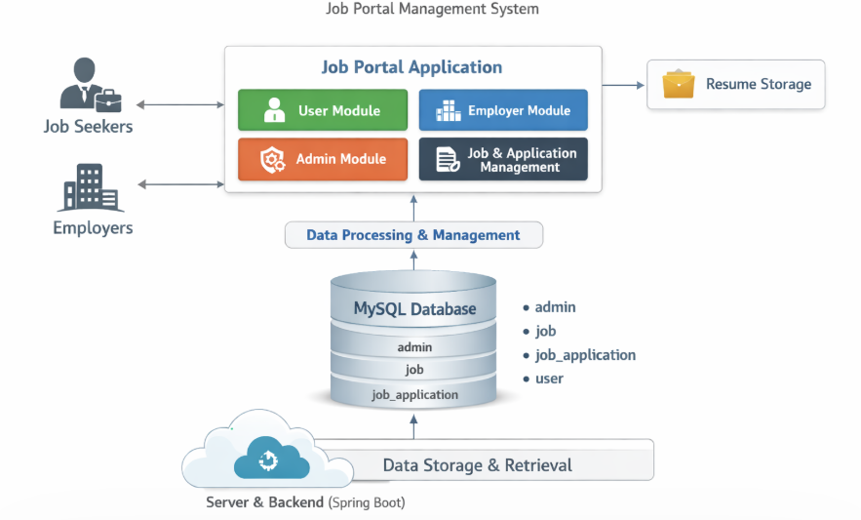
PROPOSED SYSTEM ARCHITECTURE
1
2
3
4
5
6
7
8
9

Slide 7
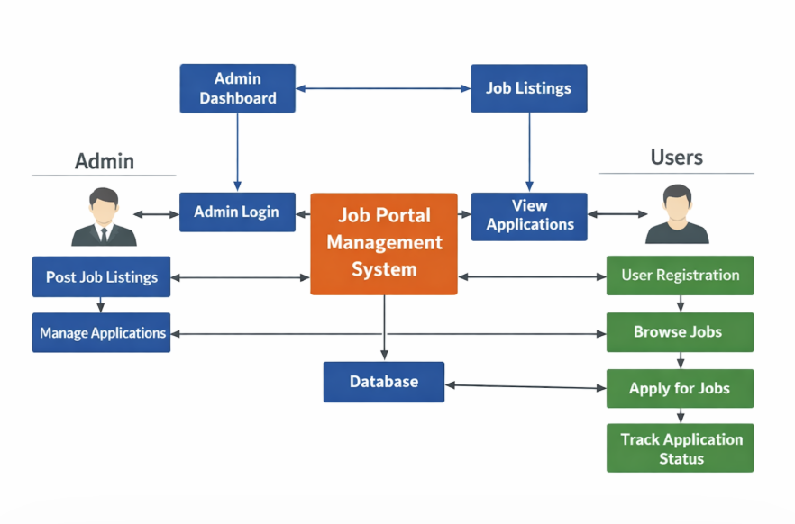
WORKFLOW
1
2
3
4
5
6
7
8
9

Slide 8
TECHNOLOGIES USED
1
Frontend: HTML, CSS, Thymeleaf (User Portal and Admin Portal Interface)
Backend: Spring Boot ,Java, REST Controllers, Service Layer
Database: MySQL (Stores Events and Booking Details)
Tools: Eclipse IDE , MySQL Workbench, Maven
Hardware/Software Requirements: Minimum 8GB RAM, Intel i3 or above, Windows 10/11, JDK 17+, MySQL Server, Web Browser (Chrome/Edge)
2
3
4
5
6
7
8
9

Slide 9
MODULE DESCRIPTION
1
Module 1: Admin Portal Management Handles admin login, job posting, job editing, job deletion, and overall job listing management by the administrator.
2
.
3
4
Module 2: User Portal Management Allows users to register, login, view available jobs, apply for jobs, and track their application status.
5
Module 3: Job Application Processing Implements application submission, validation of user details, prevention of duplicate applications, and updating application status.
6
7
.
8
Module 4: Database Management Manages storage and retrieval of admin details, user data, job listings, and job applications, ensuring data consistency and integrity.
9

Slide 10
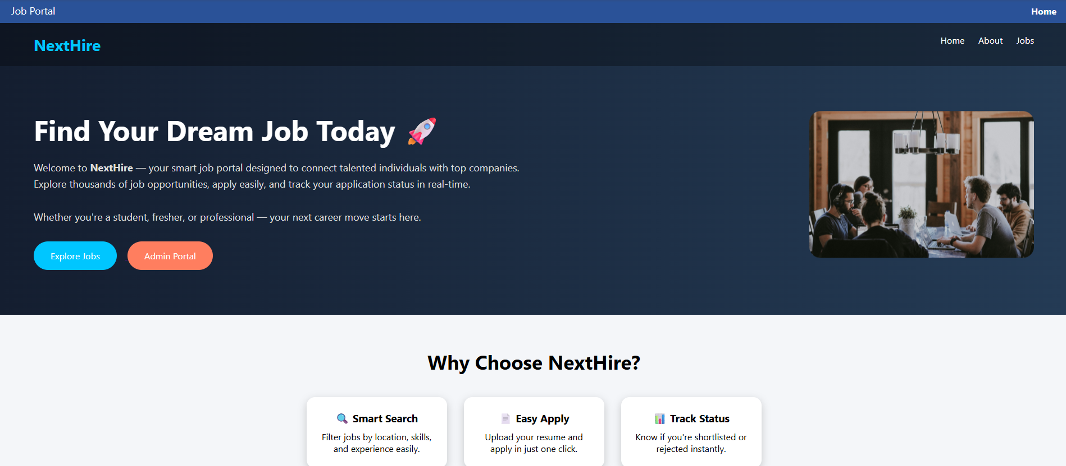
IMPLEMENTATION SCREENSHOTS
Home
1
2
3
4
5
6
7
8
9

Slide 11
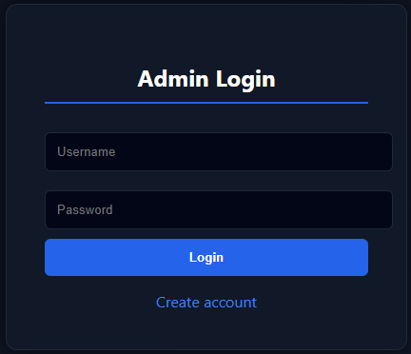
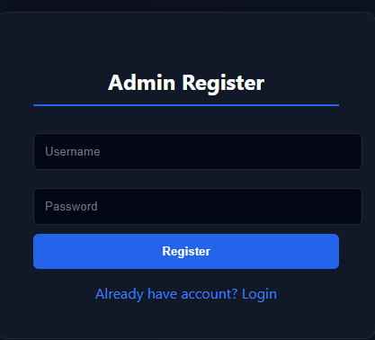
IMPLEMENTATION SCREENSHOTS
Admit login
1
2
3
4
5
6
7
8(A)
9
This page allows the administrator to securely log in using a username and password.

Slide 12
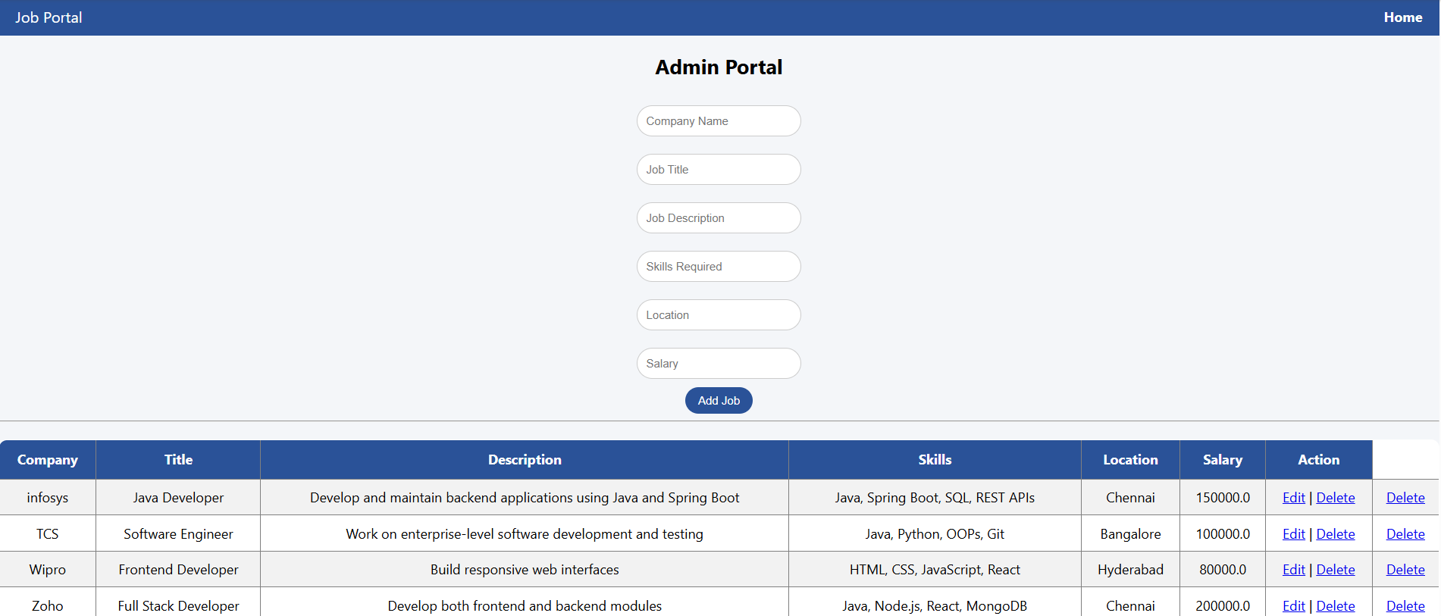
IMPLEMENTATION SCREENSHOTS
1
2
3
4
5
6
7
8(B)
9
This dashboard allows the admin to create new jobs, delete jobs and manage current jobs details.

Slide 13
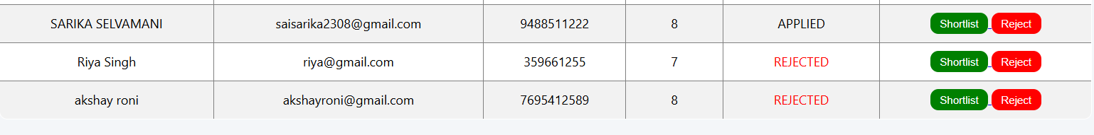
IMPLEMENTATION SCREENSHOTS
1
2
3
4
5
6
7
8(B)
9
This dashboard allows the admin to create new events, delete events, and manage current event details. It also displays all system bookings with ticket status and total price for monitoring and control

Slide 14
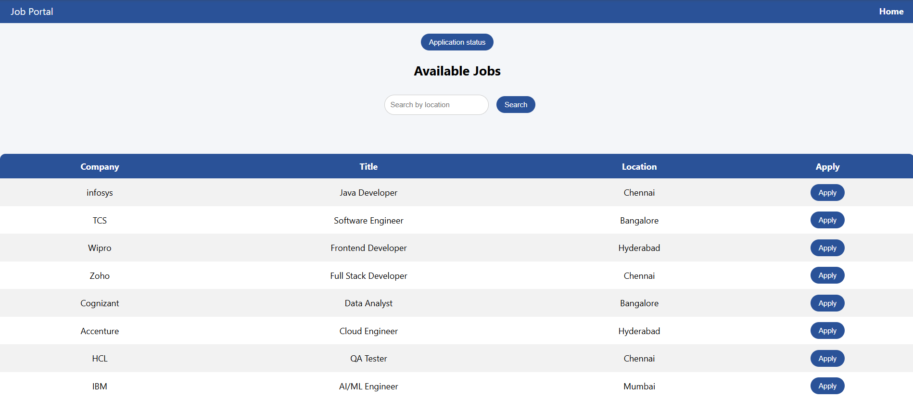
IMPLEMENTATION SCREENSHOTS
1
2
3
4
5
6
7
8(C)
9

Slide 15
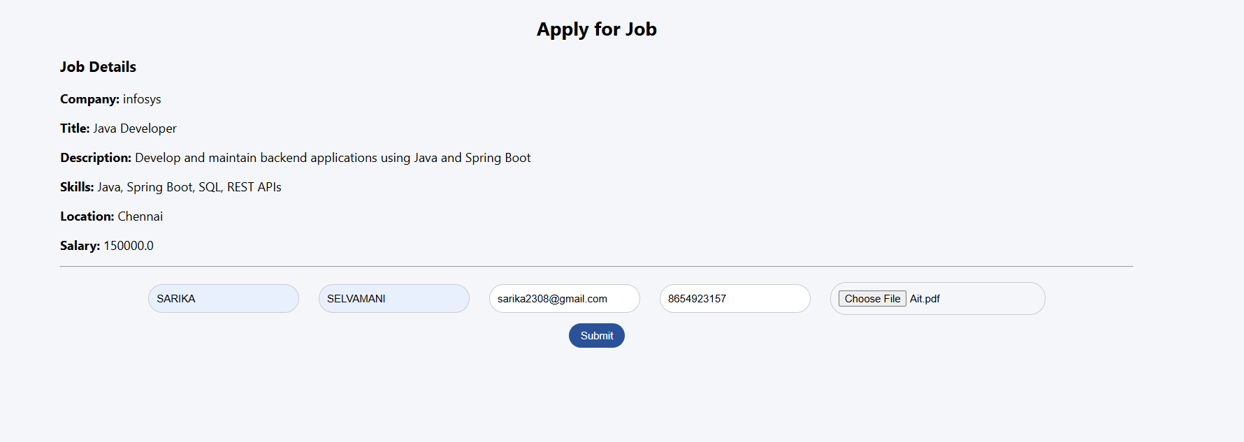
IMPLEMENTATION SCREENSHOTS
1
2
3
4
5
6
7
8(C)
9

Slide 16
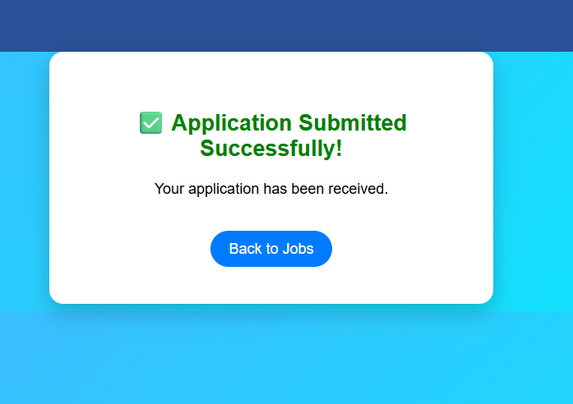
IMPLEMENTATION SCREENSHOTS
1
2
3
4
5
6
7
8(C)
9
This page provides a user portal where guests can view a list of "Available Events" with details like venue and seat count. Users can book new tickets or manage their current reservations in the "My Bookings" section, which includes an option to cancel specific quantities.

Slide 17
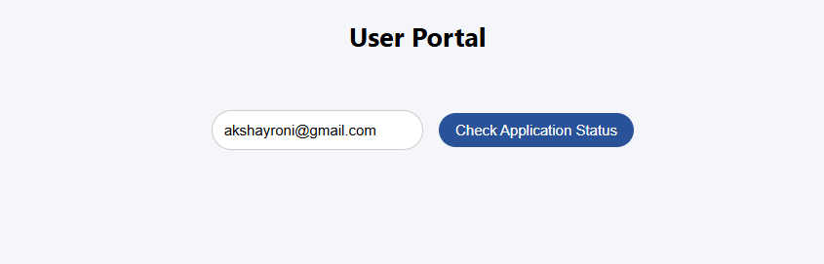
IMPLEMENTATION SCREENSHOTS
1
2
3
4
5
6
7
8(C)
9

Slide 18
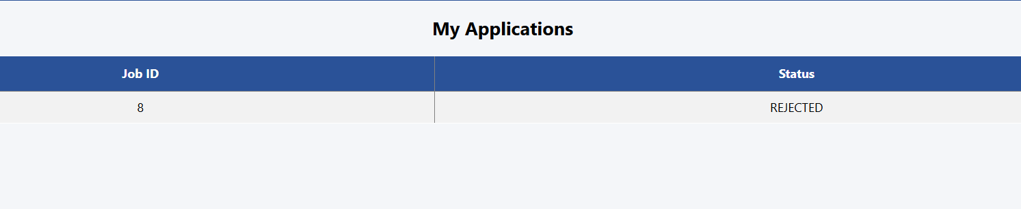
IMPLEMENTATION SCREENSHOTS
1
2
3
4
5
6
7
8(C)
9

Slide 19
ADVANTAGES & LIMITATIONS
1
Advantages
Easy Job Access Users can quickly find and apply for jobs from anywhere without visiting companies physically.
Time Saving Reduces manual work for both admin and users by automating job posting and application processes.
2
3
4
5
Limitations
Data Security Risks Sensitive user data (like personal details) must be protected from cyber threats
Data Security Risks Sensitive user data (like personal details) must be protected from cyber threats.
6
7
8
9

Slide 20
Thank you

